Slide 1

Project: G2M Insight For Cab Investment Firm
Data Science Virtual Internship
Submitted by: Aparna Virupakshi
Date: 13-June-2024

Slide 2
Outline
Problem Statement
Understanding the Data
Exploratory Data Analysis
Hypothesis Tests
Summary

Slide 3
Problem Statement
XYZ is a private equity firm based in the US. Due to the remarkable growth in the cab industry over the last few years and the presence of multiple key players in the market, XYZ is considering an investment in this sector.
Objective: The goal is to provide actionable insights to help XYZ identify the most suitable cab company for investment.
Analysis:
Data Understanding and Visualization
Finding the Most Users Cab Company
Finding the cheapest Cab Company for users
Finding the Most Profitable Cab Company
Multi Hypothesis Testing and Investigation

Slide 4
Understanding the Data
Cab_Data.csv: Contains detailed records of transactions from two cab companies.
Customer_ID.csv: A mapping table that provides a unique identifier to link customers with their demographic information.
Transaction_ID.csv: A mapping table that links transactions to customers and specifies the payment mode.
City.csv: Lists various US cities along with their population and the number of cab users.

Slide 5
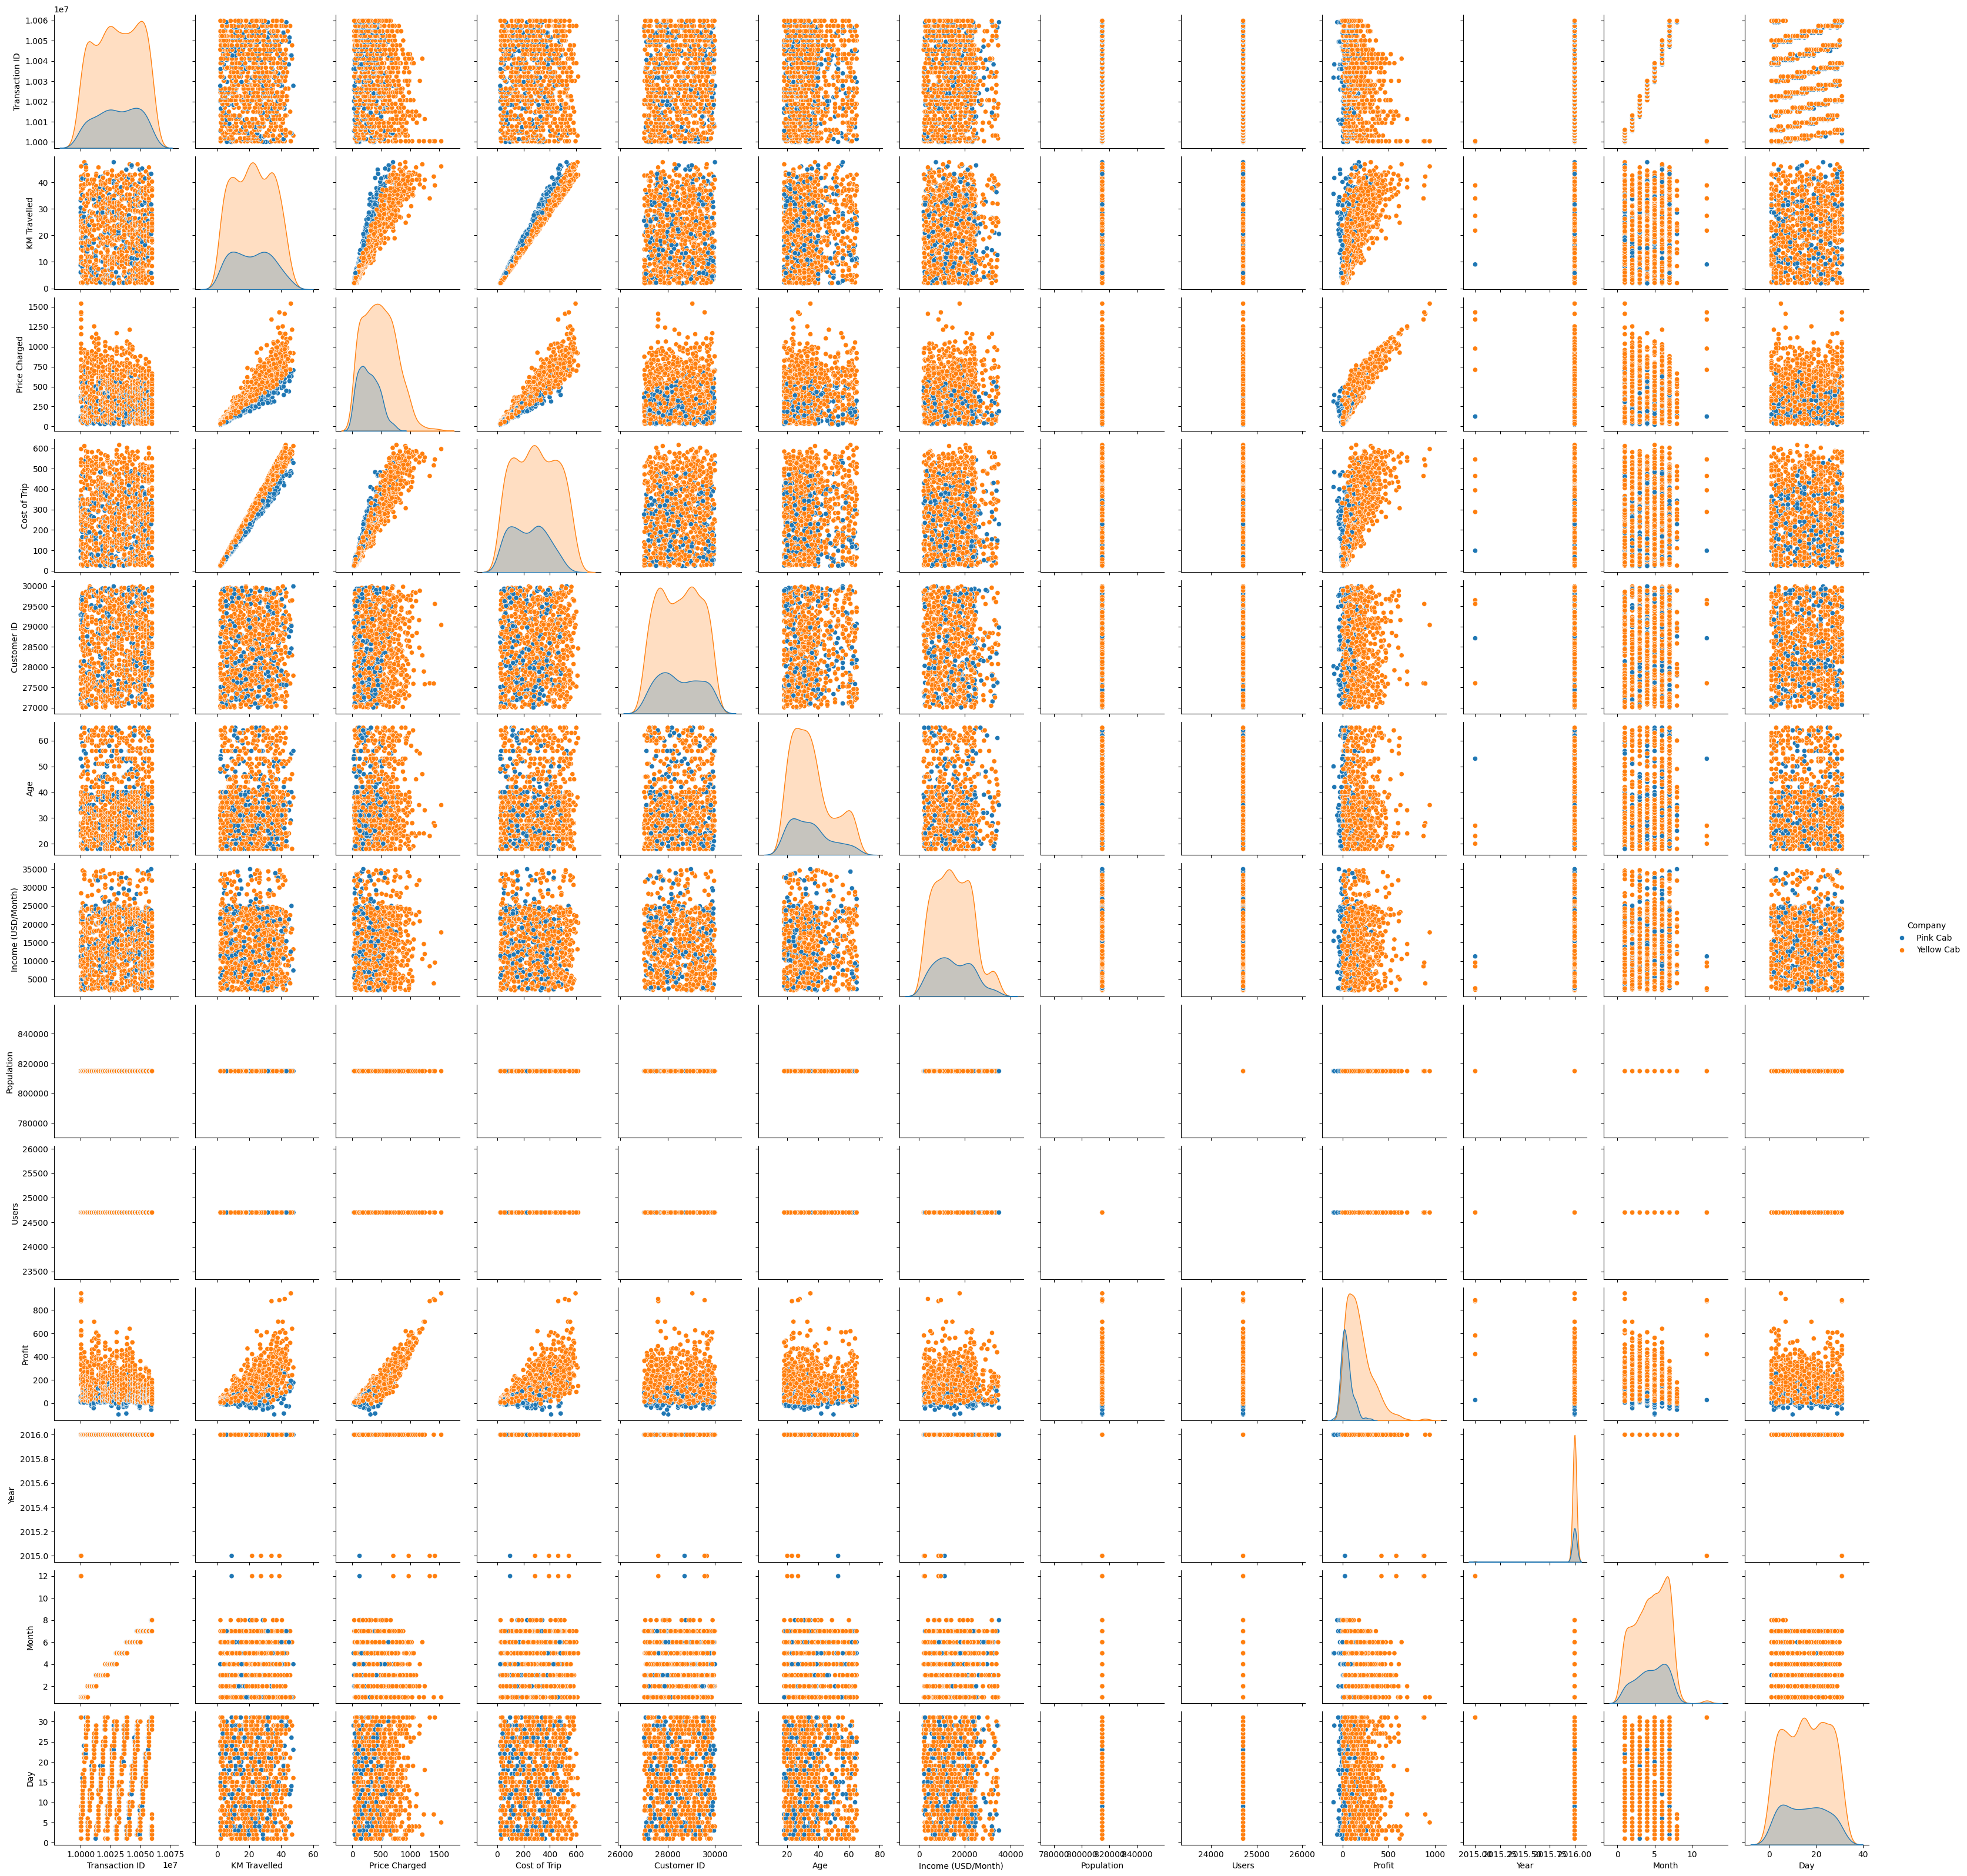
Relationships Between Variables

Slide 6
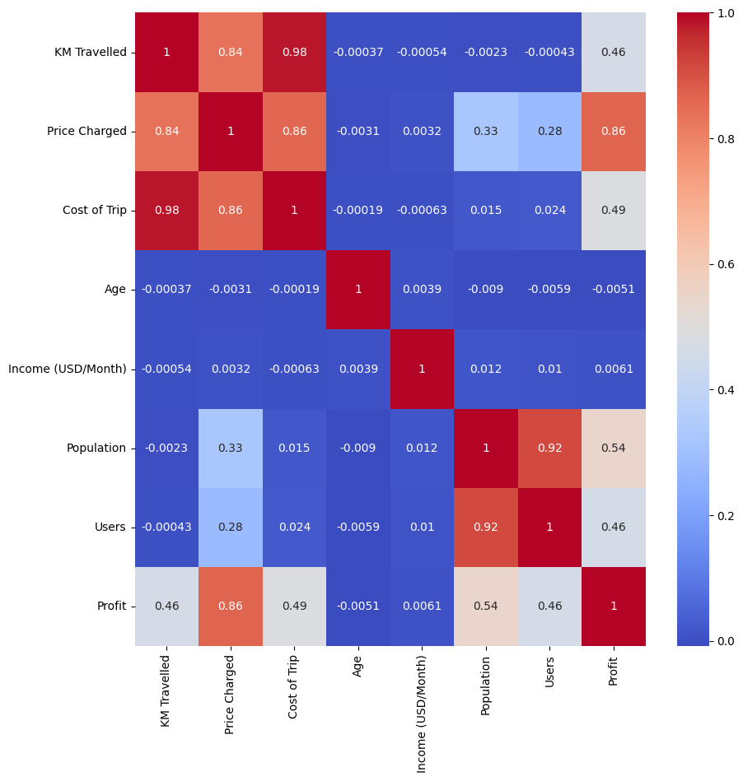
Correlation Between Variables
1. The heatmap shows that KM Travelled is very much related to the Cost of Trip and Price Charged
2. Strong correlation between Population and Users as well which is very obvious.

Slide 7
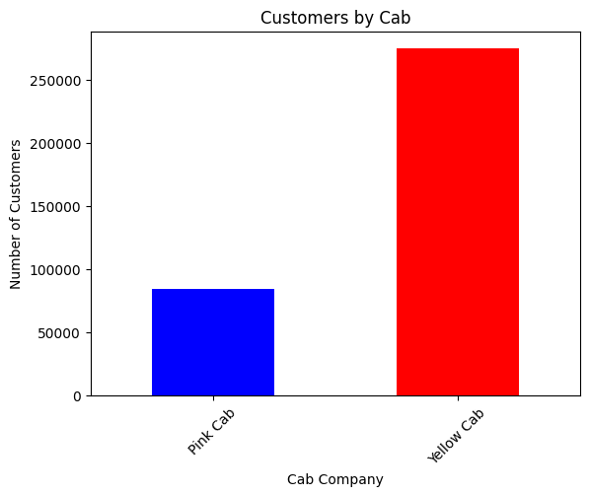
Which Company has more Customers?
Most of the customers ride on Yellow Cab compared to Pink Cab

Slide 8
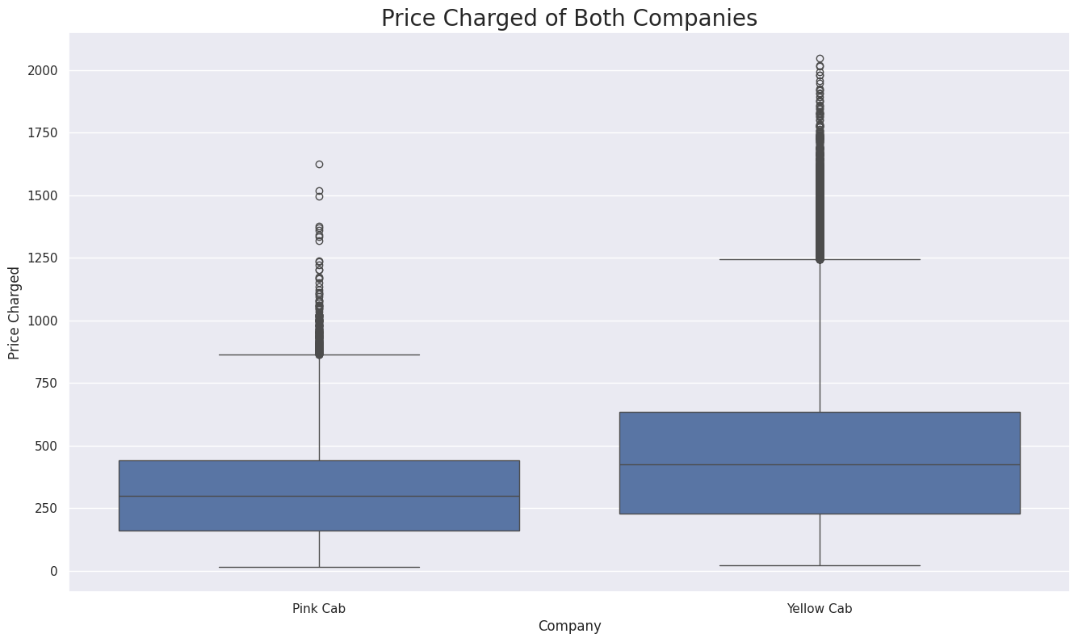
Which Company has a high price charged?
The price charged for Yellow Cab is higher than Pink Cab.

Slide 9
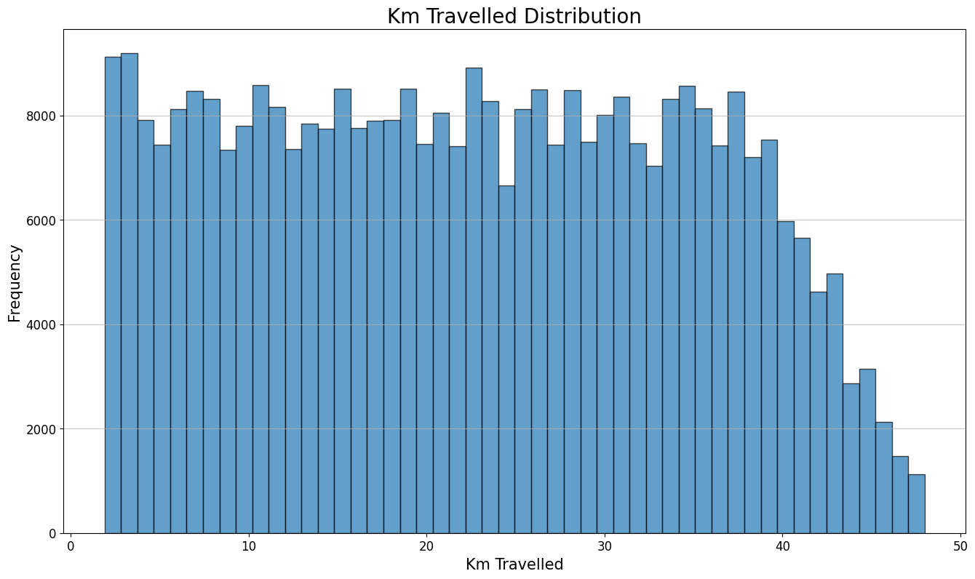
KM Travelled Distribution
The highest frequencies are observed in the range of 0 to 10 kilometers, suggesting that short-distance trips are the most common.
The histogram shows a relatively uniform distribution of trips up to around 30 kilometers, indicating a high frequency of short to mid-range trips.

Slide 10
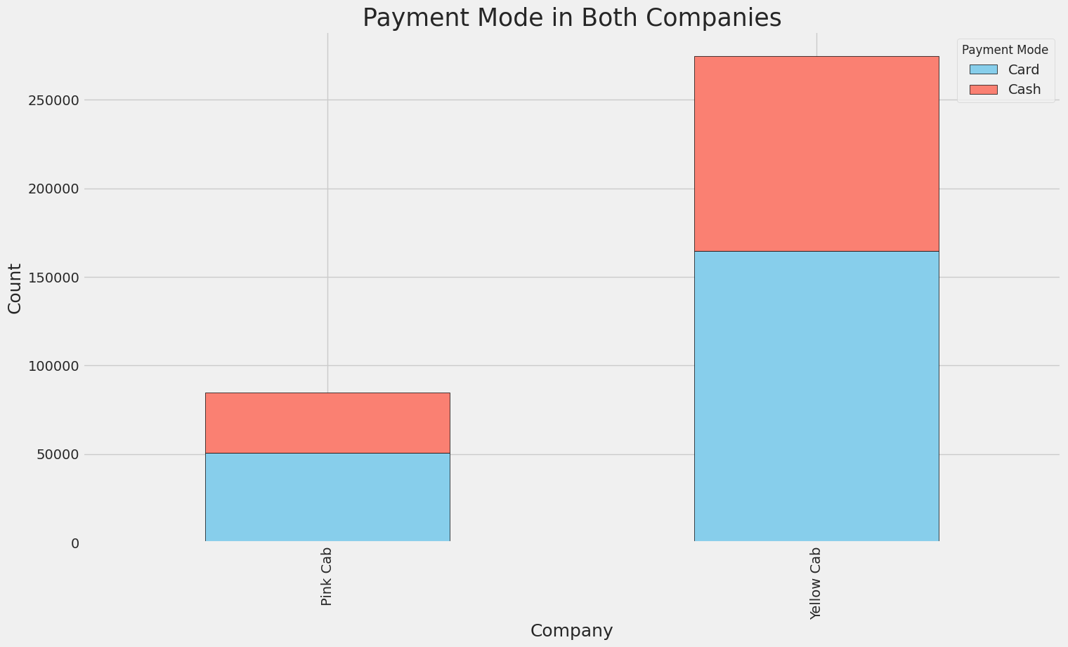
Payment Mode In Both Companies
For Yellow Cab, the number of card payments is almost double the number of cash payments. This indicates a strong preference for cashless transactions among Yellow Cab users.
For Pink Cab, the distribution is more even, suggesting that both payment modes are similarly popular among its users.

Slide 11
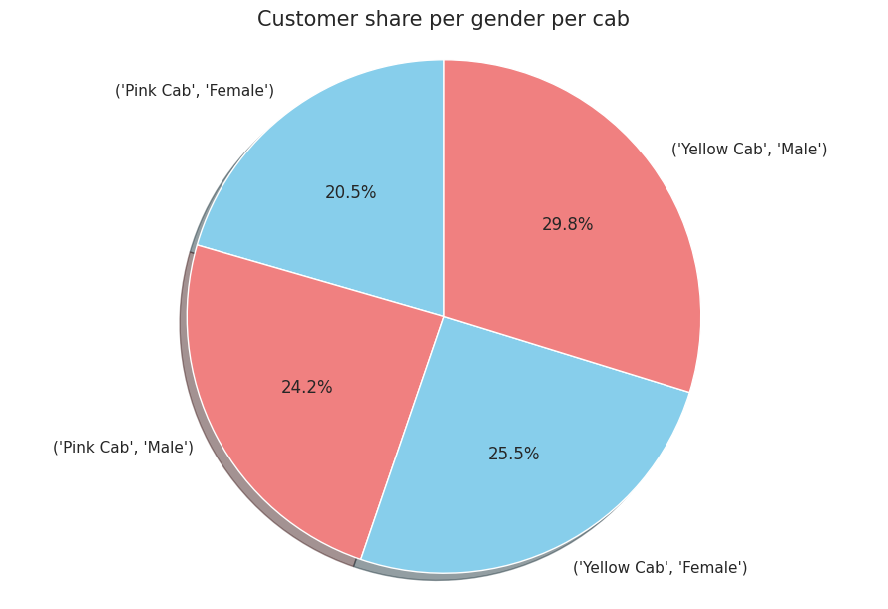
Users concerning Gender
Male Customers:
Yellow Cab has a higher percentage of male customers (29.8%) compared to Pink Cab (24.2%).
Female Customers:
Yellow Cab also has a slightly higher percentage of female customers (25.5%) compared to Pink Cab (20.5%).
Overall, Yellow Cab has a larger share of both male and female customers compared to Pink Cab.

Slide 12
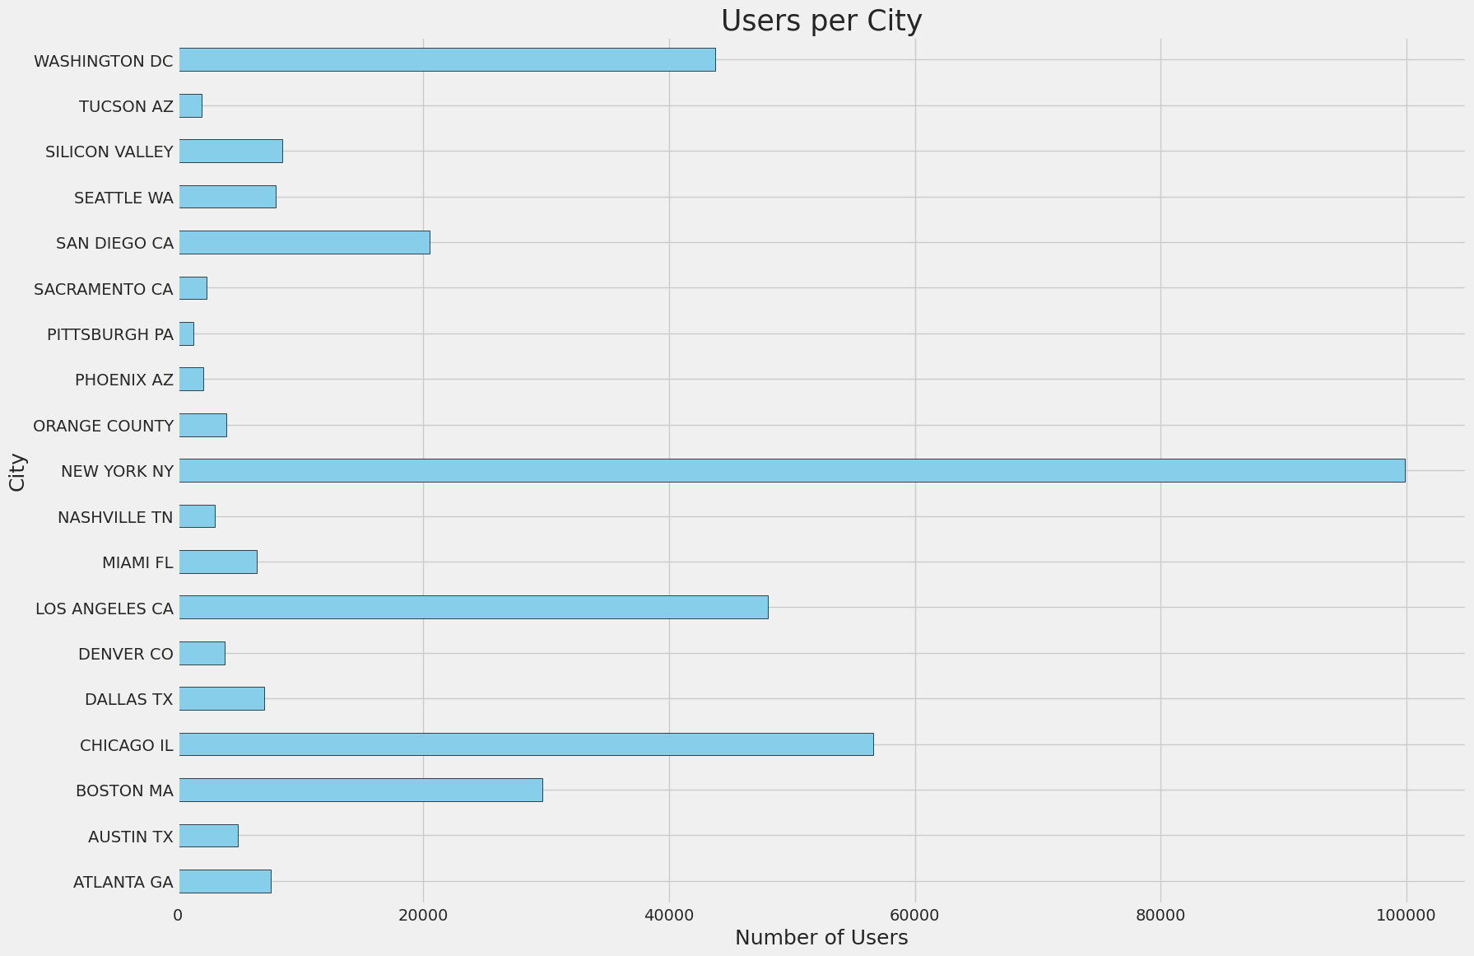
Users concerning Cities
New York City has the highest Cab Users followed by
Chicago,
Los Angeles

Slide 13
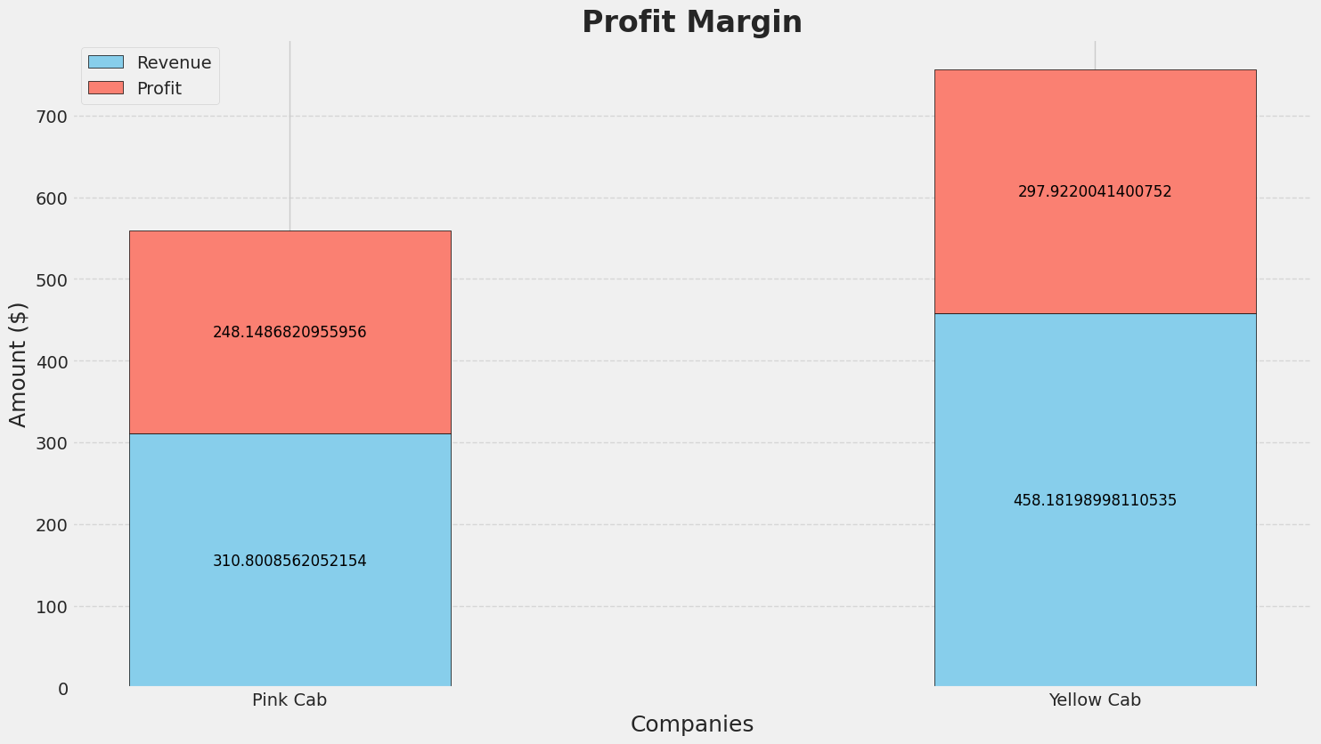
Profit Margin
Yellow cabs has a higher profit margin (297.922) Compared to Pink Cab

Slide 14
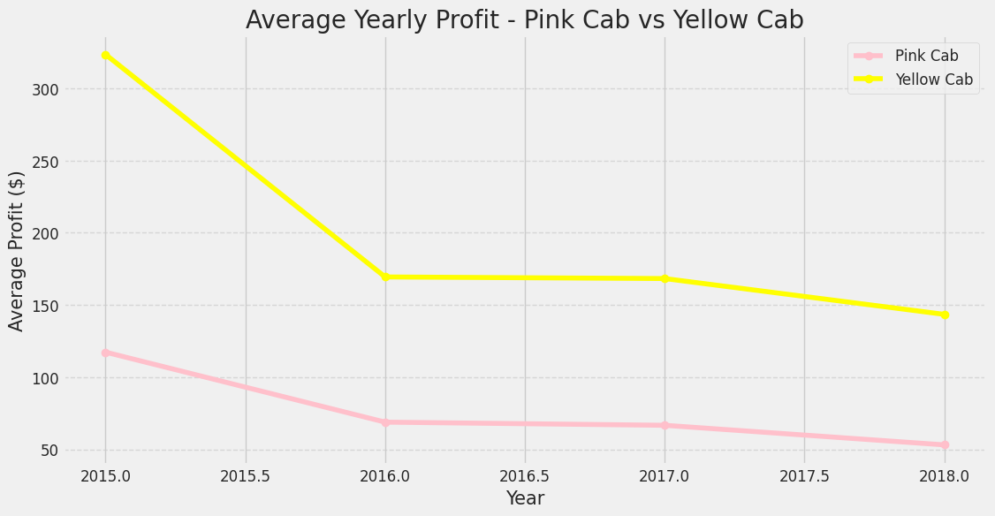
Average Profit Margin With Respect to Year
The Average Profit Margin with respect to Year is decreased
Yellow cabs has a higher profit margin compare to Pink Cab

Slide 15
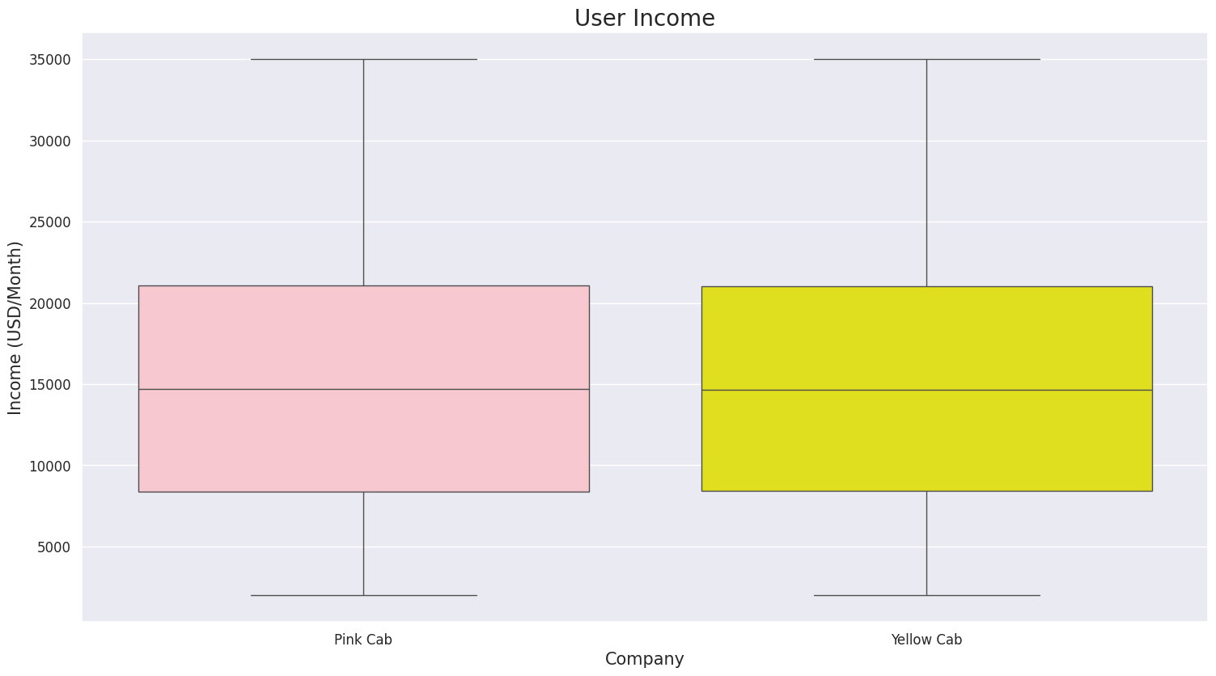
Average Income of Users
The median income for users of both Pink Cab and Yellow Cab is around $15,000 USD/month. This is indicated by the line inside each box, representing the median.

Slide 16
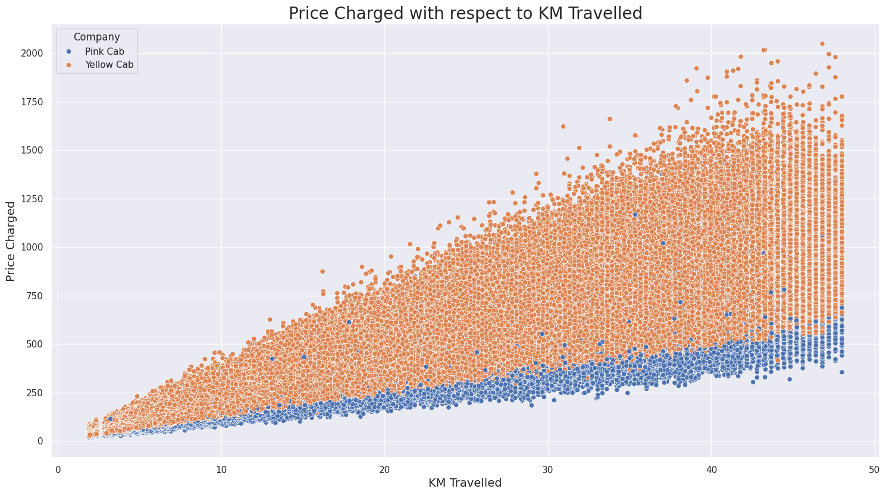
Price Charged With Respect to KM Travelled
Yellow Cab:
The data points for Yellow Cab are consistently higher compared to Pink Cab for the same distances, indicating that Yellow Cab generally
charges more for similar distances compared to Pink Cab.
Pink Cab:
The data points for Pink Cab are lower, showing that Pink Cab charges less for the same distance.

Slide 17
Hypothesis 1: Does anything make a difference in Profit regarding Payment Mode
Pink Cab Company
Yellow Cab Company
H0: There is no difference regarding payment mode in both cab companies.
H1: There is a difference regarding payment mode in both cab companies.
Conclusion
There is no difference regarding Payment Mode in both cab companies

Slide 18
Hypothesis 2: Does anything make a difference in gender distribution between companies
Chi-Square Test for Proportions:
Conclusion
H0: There is no difference regarding Gender in both cab companies.
H1: There is a difference regarding Gender in both cab companies.
There is a difference in gender distribution between companies

Slide 19
Hypothesis 3: Correlation between KM Traveled & Price Charged
Correlation Test:
H0: There is no significant correlation between KM traveled and Price charged.
H1: There is a significant correlation between KM traveled and Price charged.
Conclusion
There is a significant correlation between KM travelled and Price charged.

Slide 20
Conclusion
Yellow Cab Company is better than Pink Cab Company Because:
Higher Profit Margin
Larger User Base
Higher Transaction per Year
Better Geographical Coverages

Slide 21

Thank You

